Slide 1
VIRTUAL LABORATORY FOR COMMUNICATION SYSTEMS
Supervisor: Dr thyla
Assistant Professor
Department of Electronics and communication Engineering
Team members:
Rojin raju – 311018106045
Sakticharan n – 311018106054
Umesh harihara sudan m – 311018106064
Batch : B7

Slide 2
CONTENTS
OBJECTIVE
INTRODUCTION
LITERATURE SURVEY
BLOCK DIAGRAM/ FLOW
EXPERIMENT LIST
DESCRIPTION
LITERATURE SURVEY
TOOLS USED
VIEW AND COMPONENTS
CONCLUSION
CONFERENCE/JOURNAL DETAILS
REFERENCES

Slide 3
OBJECTIVE
To make available the experiments from the Lab readily Available in the virtual space.
That makes it accessible from anywhere.
Can be accessed anytime for learning .
To enable remote learning.

Slide 4
INTRODUCTION
Firstly the main aim of the simulation for experiments is get it accessible for everyone and the need for this arose during the pandemic where educational institutions where struggling mainly because of two reason:
1.the lack of awareness about virtual learning of experiment.
2.Lack of infrastructure for Virtual lab (Earlier most of the virtual labs were based on java applet for which the support has ended)
Our approach of virtual lab has been proposed keeping all the hurdles faced earlier:
1.Our tech stack is based on HTML,Css,Js which will have support until there comes a end of Website Era.
2.simple and easy to use simulation which makes it user friendly and also light weight in terms of deployment.

Slide 5
Block Diagram/Flow of the Experiment
Aim
(Aim of the Exp is stated in this Page)
Theory (Here theoretical concept will be available)
Procedure
(Steps to followed to execute the experiment)
Pre-Test Quiz
(Helps to assess the understanding before the experiment)
Post-test
(Helps to assess the understanding before the experiment)
Simulation
(The step in the Procedure to be followe to complete the simulation)

Slide 6
EXPERIMENT LIST The following Experiments are executed using the virtual lab software for the betterment of output values rather than the physical output values, 1. Frequency modulation (FM) 2. Frequency shift keying (FSK) 3. Amplitude shift keying (ASK) 4.Pulse code modulation(PCM) 5.Amplitude Modulation(AM)

Slide 7
DESCRIPTION
Sections will be Aim, Theory, Procedure, Pretest, Simulation, Posttest and References.
By reading detailed theory section the user will get to know the theoretical concepts of the experiment which will make it easy for them to understand the simulation when done in physically. Further, reference will be given to deepen the knowledge about the experiment
To understand the experiment simulation, detailed step by step procedure will be given to help the students to conduct simulation in better way
Quiz questions will be provided during experiment simulation to engage the students effectively & more interaction
Pre-test and Post-test questions will be provided to assess the students and to make them explore more

Slide 8
LITERATURE SURVEY
Shyam diwakar, krishnashree achuthan and prema nedungadi have published a paper on biotechnology virtual labs- integrating wet-lab techniques and theoretical learning for enhanced learning at universities. Establishing virtual labs requires both domain knowledge and virtualizing skills via programming, animation and device-based feedback.
Challenges in the biotechnology sector in setting up a laboratory that integrates both the feel and phenomenon includes the medley of multiple techniques.
The major challenge in setting up an effective knowledge dissemination for laboratory courses was not only the scientific approach of biotechnology, but included the virtualization aspects such as usage/design scalability, deliverability efficiency, network connectivity issues, security and speed of adaptability to incorporate and update changes into existing experiments.
This paper also discusses an issue-specific case-study of a functional virtual lab in biotechnology and its many issues and challenges.

Slide 9
LITERATURE SURVEY
Jai P. Agrawal and yakov E cherner have published a paper on “A classroom/distance learning engineering course on wireless networking with virtual lab”.
Paper presents the design of an engineering course on “wireless networking” in a traditional classroom /distance learning format.
The paper will also show that how classroom learning can be enhanced by making available to learners the classroom lecture in audio /video/pdf format from anywhere and at all times on demand.

Slide 10
LITERATURE SURVEY
Lavanya rajendran, ramachandran veilumuthu and divya. J paper on study on the effectiveness of virtual lab in e-learning.
The research aims to identify the effectiveness of virtual lab in e-learning suite. The study aims to analyse the increase in learning skills and the understanding level of concepts by implementing virtual lab among school students in chennai.
The study also focuses on identifying whether the virtual lab helps the students to increase the self-paced learning. The study suggests that the virtual labs have to be adopted in schools for making their students think out of the box.

Slide 11
LITERATURE SURVEY
S. Diwakar, D. Kumar, R. Radhamani, H. Sasidharakurup, N. Nizar, K. Achuthan, P. Nedungadi, R. Raman, and B. Nair paper on complementing education via virtual labs: implementation and deployment of remote laboratories and usage analysis in south indian villages.
Enabled virtual and remote labs have become a platform augmenting user engagement in blended education scenarios enhancing university education in rural india.
A novel trend is the use of remote laboratories as learning and teaching tools in classrooms and elsewhere.
This paper reports case studies based on our deployment of 20 web-based virtual labs with more than 170+ online experiments in biotechnology and biomedical engineering discipline with content for undergraduate and postgraduate education.

Slide 12
TOOLS USED
Html (hypertext markup language): it is the most basic building block of the web page. It defines the structure and meaning of web content.
2. CSS (cascading style sheets (CSS): it is a stylesheet language used to describe the presentation of a document written in HTML or XML. CSS describes how elements should be rendered on screen, on paper, in speech, or on other media.
3. Javascript: it is a lightweight, interpreted, or just-in-time compiled programming language with first-class functions. While it is most well-known as the scripting language for web pages, many non-browser environments also use it.
Software:
Visual studio code
Chrome/ firefox /edge browser.

Slide 13
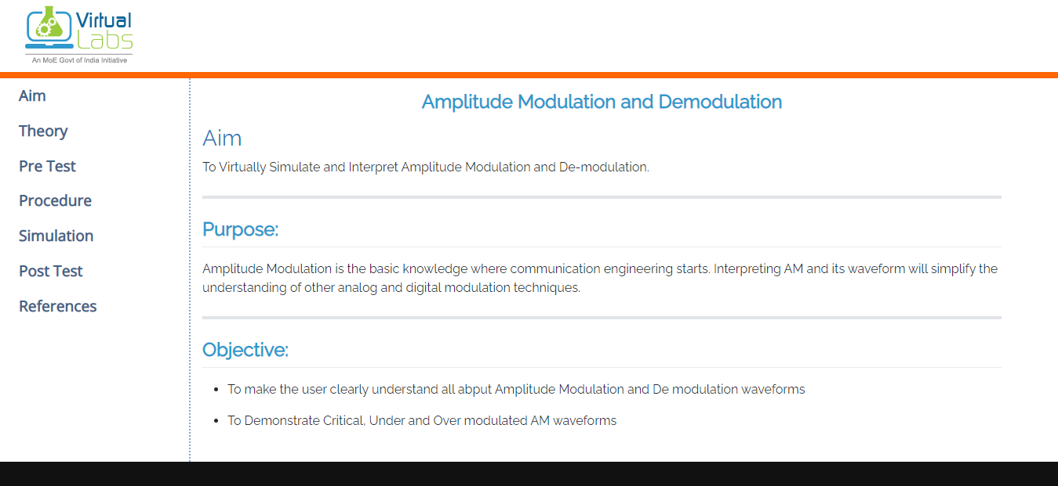
View and Components
Home Page for an Experiment with all the Sub tabs Link

Slide 14
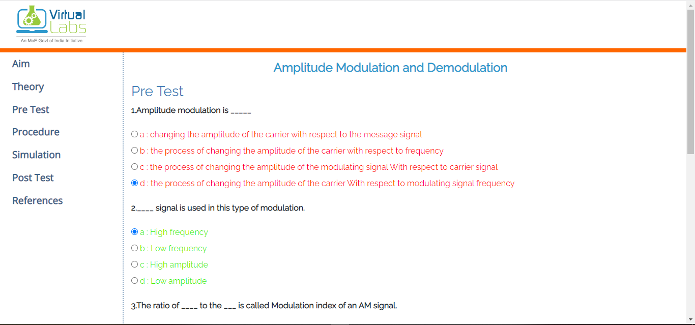
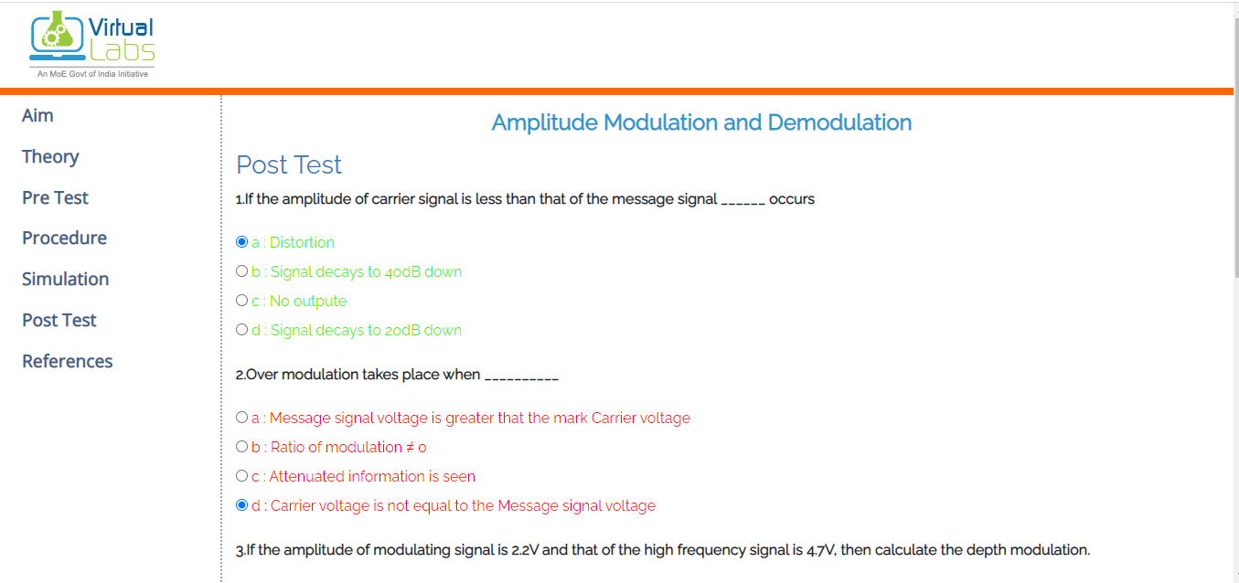
Interactive Quiz
Quiz before and after the simulation to assess the understating of the student .

Slide 15
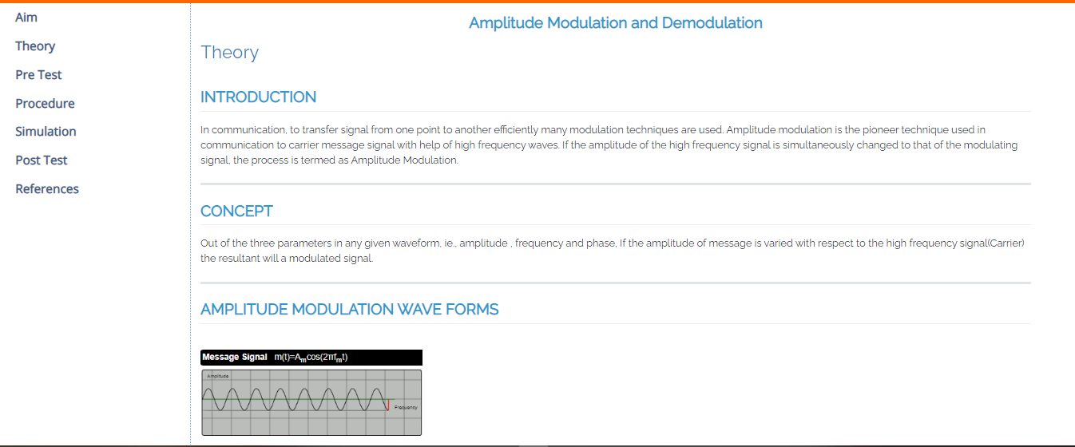
Theroy and Procedure
To also understand the theoretical concepts of the experiment and the step to conduct the experiment are clearly stated

Slide 16
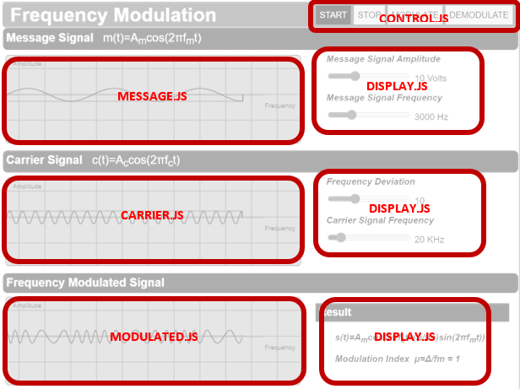
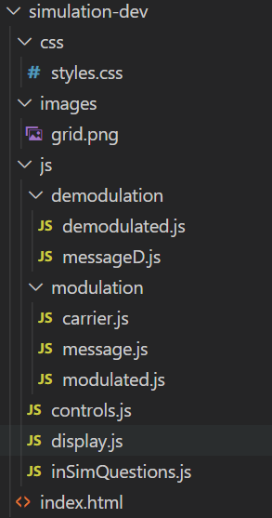
COMPONENTS

Slide 17
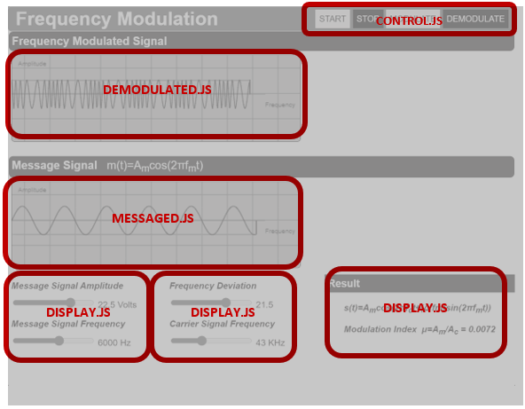
COMPONENTS

Slide 18
CONCLUSION
In today's world everyone is worried about the standard of the education system and practical knowledge for student due to the sudden outburst of a pandemic.
As a result, it was unable for the students to attend on-campus class. This has led to the increase in the importance of technology.
In this project it has been enabled to delivery the practical experience of executing the laboratory experiments through digital mode .This not only helps during situations like pandemic it also help to reach out rural educational institutions.

Slide 19
CONFERENCE /JOURNAL

Slide 20
REFERENCE
Shyam diwakar, krishnashree achuthan and prema nedungadi. “Biotechnology virtual labs- integrating wet-lab techniques and theoretical learning for enhanced learning at universities.”
2. Jai P. Agrawal and yakov E cherner. “A classroom/distance learning engineering course on wireless networking with virtual lab”.
Lavanya rajendran, ramachandran veilumuthu and divya. J. “Study on the effectiveness of virtual lab in e-learning”
S. Diwakar, D. Kumar, R. Radhamani, H. Sasidharakurup, N. Nizar, K. Achuthan, P. Nedungadi, R. Raman, and B. Nair paper on complementing education via virtual labs: implementation and deployment of remote laboratories and usage analysis in south indian villages

Slide 21
THANK YOU

